Slide 1
Query Execution

Slide 2
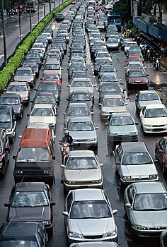
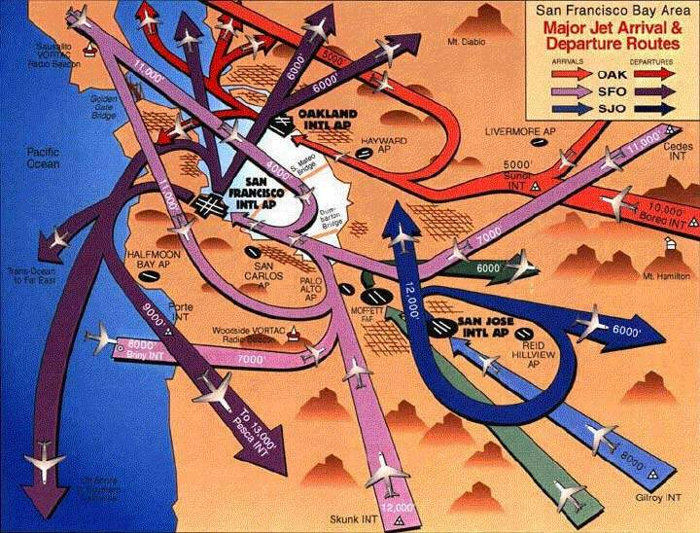

Understanding resources

Slide 3
What is a Plan
Calculated method to complete a given task
How?
Indexes
Statistics
Hints

Slide 4
Query Plans
Cost
Operators
Seeks/Scans
Joins
Sorting
Calculations
Indexing
Covering indexes
Sort order
Estimation

Slide 5
Cost
Is based on a machine many years ago
Doesn't equate to anything specific
Useful for comparison
Shouldn't be used in isolation
Doesn't consider server state
Available memory
Pages in memory already
High end disk (ram disk, SSD)

Slide 6
Building a Plan
Seek vs Scan
Choosing an Index
Cardinality
Covering vs Non Covering
Filtered Indexes

Slide 7
Statistics
Histogram of column(s) contents
Estimated from a sample (usually)
Auto generated (usually)
Never auto generated on multiple columns (except indexes)
Manually update with UPDATE STATISTICS

Slide 8
Screenshot
Create demo of DBCC SHOWSTATISTICS
Histogram

Slide 9
Parallelism
The use of multiple cpus/cores
Controlled by server level configuration
Overwritten by query hint (MAXDOP)
Not always possible
Distinct Count
Not always wanted
Skewed statistics leads to uneven threads (CXPACKET)

Slide 10
Screenshot
Create a demo showing execution plan for parallel vs non parallel

Slide 11
Foreign Keys
Views that have unnecessary joins can slow queries if:
They are missing Foreign Keys
Or, the Foreign key is untrusted
By having trusted keys the join does not need to be checked when not in use

Slide 12
Estimates
Plans are based on estimates
Based on statistics or fixed estimates
Statistics need updating
Especially where distributions change
i.e. time based data
Query has to run to get actuals

Slide 13
Statistics Again
The tipping point
At some point SQL will estimate that it is quicker/more efficient to scan an table rather than seek on a index
Usually around 30% of the pages in the table are being read
Varies based on parallelism
Or, memory pressure
Never happens on a covering non clustered index

Slide 14
Plan reuse
Reuse
Guaranteed plan
Sub optimal
No reuse
Execution time Compile
Optimal plan
Plan cache bloat
Notes:
If execution time much > than compile time, why worry - > plan bloat
If execution time < compile time then really worry about it.
OLTP plan reuse
ETL, Reporting plan no reuse

Slide 15
Why plan reuse
Compilation can take longer than execution time
We want predictable results
Use our memory for data and not adhoc plans

Slide 16
Join Types
LOOP
Fast for small datasets
Used for bookmark lookups
Bad is wrong estimates
MERGE
Very fast
Requires both sides to be sorted
HASH
Hashes data, heavy on CPU/tempdb
Best for very large joins

Slide 17
Plan Caching
Creating plans is slow/expensive in an OLTP world
Not so much of an issue for warehouses
sys.dm_exec_cached_plans - View
sys.dm_exec_query_plan - Function

Slide 18
Parameterization
Query:
SELECT * FROM Sales WHERE SaleID = 1001
Becomes:
SELECT * FROM Sales WHERE SaleID = @p1
This increases the chance of a cache hit and reduces memory usage
Forced Parameterization
Works on literal strings
Will parameterize more queries
But will increase chances of wrong plan

Slide 19
Viewing the Plan
Estimated Plan
Actual Plan

Slide 20
Demo
Finding a plan
Viewing the plan

Slide 21
ORMs
nHiberbate/Linq
Adhoc Plan Caching
Server setting to cache on 2nd execution only to save memory

Slide 22
When do plans change?
Statistics Change
Object Changed
Forced Recompile

Slide 23
Hints
RECOMPILE/With Recompile
Prevents the plan from being cached
Parameterization will not take place
FORCE ORDER
FORCE SEEK/SCAN
MAXDOP
INDEX [IndexName]
UNKNOWN

Slide 24
Notes
Threshold Cost
Paramistasion
SET options
Linked Servers

